Slide 1


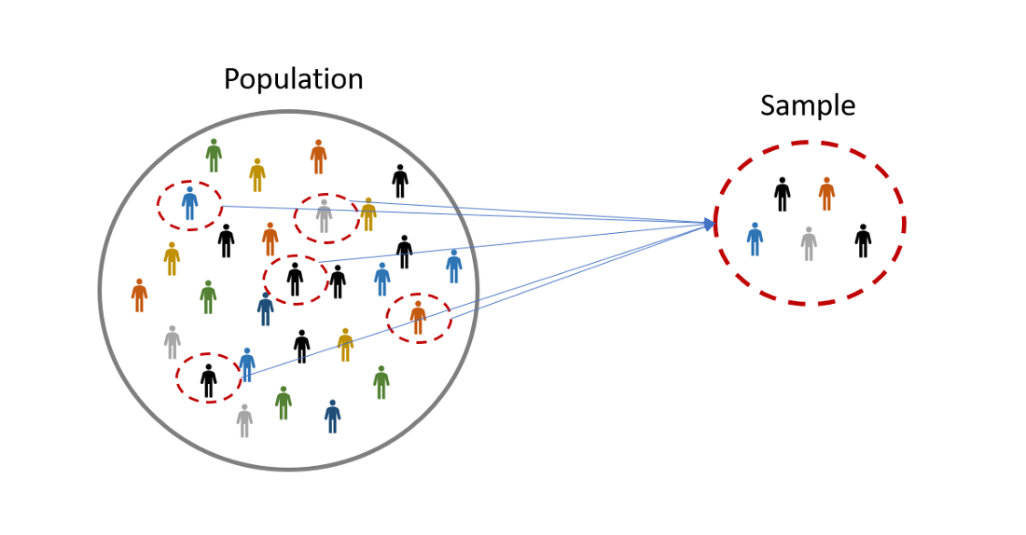
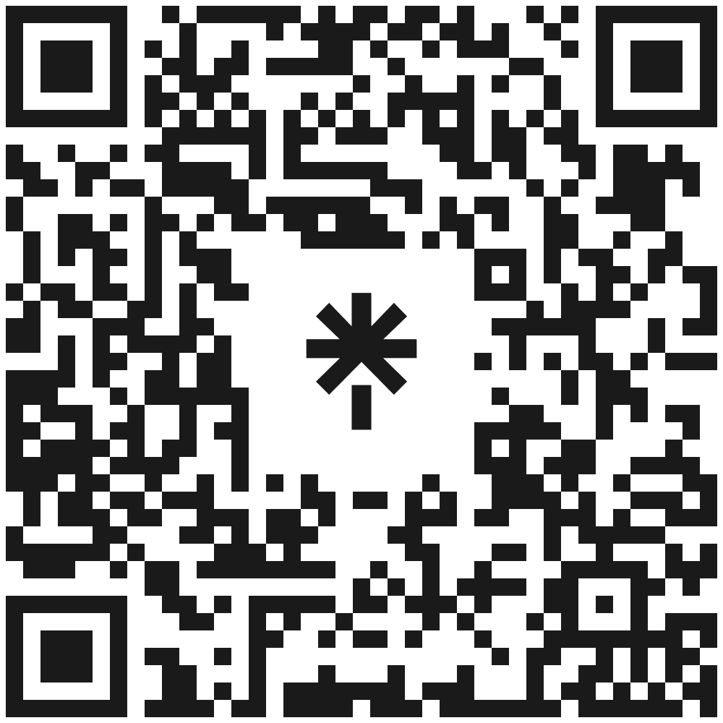
Differentially Private Measures of Statistical Heterogeneity
Mary Scott, Graham Cormode and Carsten Maple
Outcomes
Explore existing and emerging research in Federated Machine Learning systems:
which tackle problem of statistical heterogeneity,
while incorporating differential privacy.
Two examples of non-i.i.d.
Skewness – data deviates from a normal distribution through a shift to one side.
Statistical (Data) Heterogeneity – asymmetry between different distributions of different subpopulations within the dataset.
Want to minimise difference between observed and general trends of entire dataset.
Differential privacy
Leading candidate to provide privacy protection.
Cannot isolate a particular user’s data from dataset
Cannot determine whether particular user is in dataset
Mathematically strong and has provable guarantees
Helps to keep political and medical information private.
Two examples of FML systems
Federated Learning – an alternative to traditional centralised ML techniques.
Federated Analytics – can measure, analyse and improve FL models.
Contact
Mary Scott
Mary.P.Scott @warwick.ac.uk

